Slide 1
E-Commerce Venture Aimed At new entrepreneurs For Musical Instruments
Presented by:
Md Rijwan Razzaq Matin
SCM-024522

Slide 2
Aims
To reduce the operating costs
To overcome the physical and geographical limitations
To be time effective.
To gather latest news and information of musical instruments
To enable the users for ordering and delivery via the system
To store relevant data and maintain a database
Notes:
The purpose of this project is to develop a system that connects users to the company’s web site that not only can be used to sell music instrument as a solution for a business operation but also to help it grow as good brand by creating a community where the entrepreneurs and the end product users both be benefited greatly.

Slide 3
objectives
To build customer loyalty
By creating an efficient channel for transactions with its customers.
To enable online transaction
with secure order over the Internet directly from the web application.
To research on how web systems are developed and applied
Front-end and back-end design (client-server)
To develop a system database
Which incorporates with the system and can fetch accurate data (Get order status)

Slide 4
Project scope
capability of storing data and information
capability of processing financial transactions
capability of retrieving data and information including financial transactions

Slide 5
Project scope
home
about
Products
Cart
checkout
search
Order status
Location
faqs
News/Events
Contact Us/Feedback
Promotion/Clearance

Slide 6
system
back-end (admin side):
User login
Product directory
Add/edit/update/delete products
Add/edit/update/delete Category
Order status (detailed)
Front-end (user side):
Product search
Product Shopping cart
Add/edit/update/delete cart
Payment/ checkout
Order status
Comments/ feedback

Slide 7
Functional requirement
System admin functions
View all existing Product Category
Add new Product Category with details
Edit existing Product Category with details
Delete Product Category if necessary
View all existing items
Add new items with details
Edit existing items with details
Delete items out of stock

Slide 8
Functional requirement
Users functions
View products with details
Search for products
Add products to cart
Edit/update products in cart
Delete products from cart
Purchase products
Check order status
Comment/feedback

Slide 9
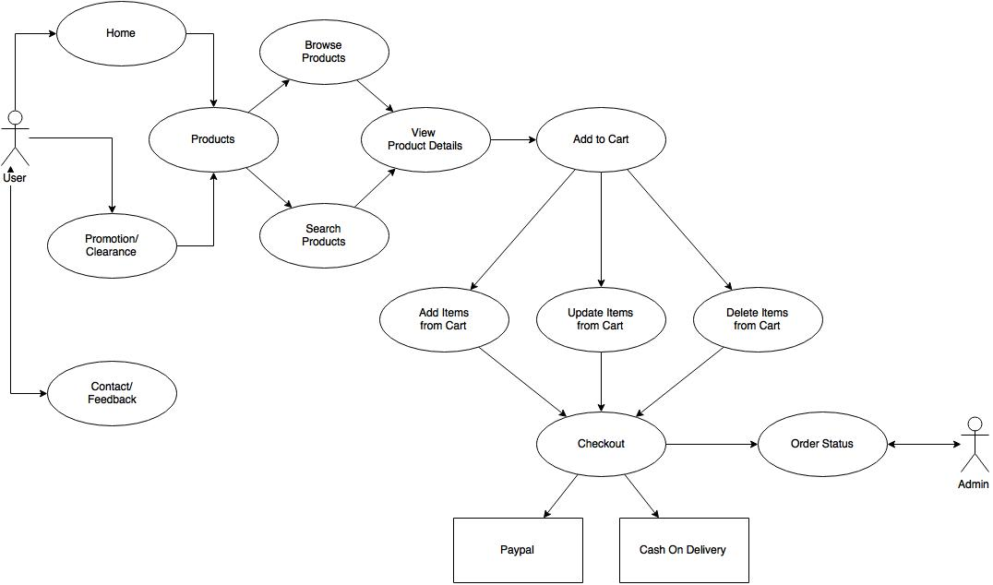
Use case diagram
Front-end

Slide 10
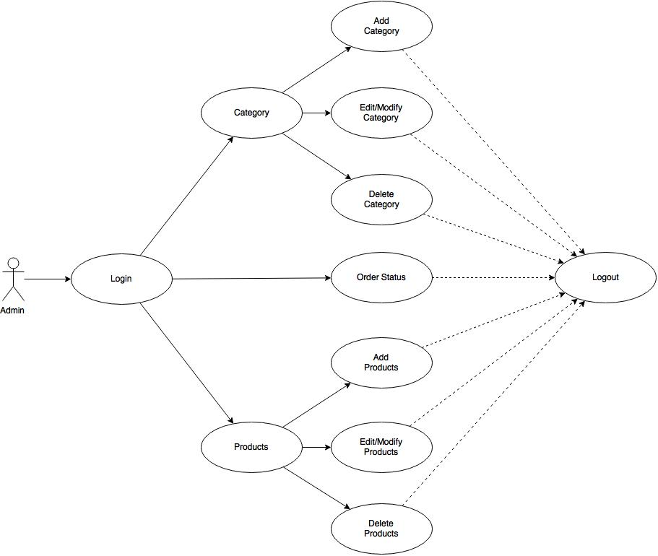
Use case diagram
back-end

Slide 11
Non-Function requirement
Availability:
System should be available for the user to use at any time.
Accessibility:
System should be accessible from different devices.
Authenticity:
System should be able to validate input fields.
Standardisation GUI:
All system pages should be same.
Performance:
System should should lag free (not Slow)
Usability:
System should be easy and friendly to use.
Capacity:
System database should be able to store large number of users.
Security:
System records should be secured and maintained.

Slide 12
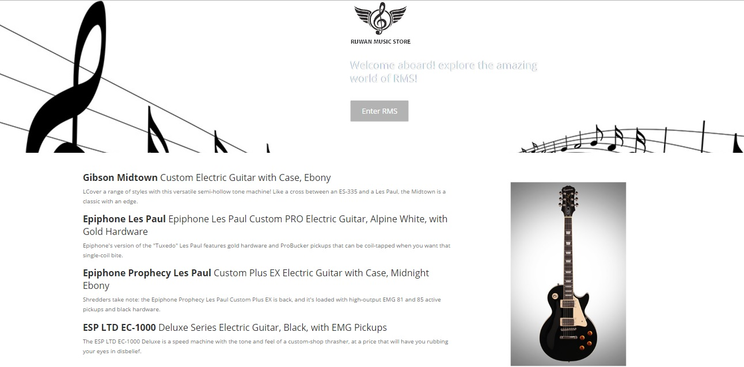
Demonstration

Slide 13
Thank You!

